Slide 1
Linear Regression for Housing price prediction
-- Gang Wei

Slide 2
Data
https://www.kaggle.com
Purpose: predict the Paris housing prices
Dependent variable: House prices
Independent variables(16 numerical):
squareMeters | numberOfRooms | hasYard | hasPool
floors | cityCode | cityPartRange | numPrevOwners
made | isNewBuilt | hasStormProtector | basement
attic | garage | hasStorageRoom | hasGuestRoom

Slide 3
Used Libraries and functions
# import necessary Python libraries
Import pandas as pd
Import numpy as np
Import matplotlib.pyplot as plt
From sklearn.linear_model import LinearRegression
From sklearn import metrics

Slide 4
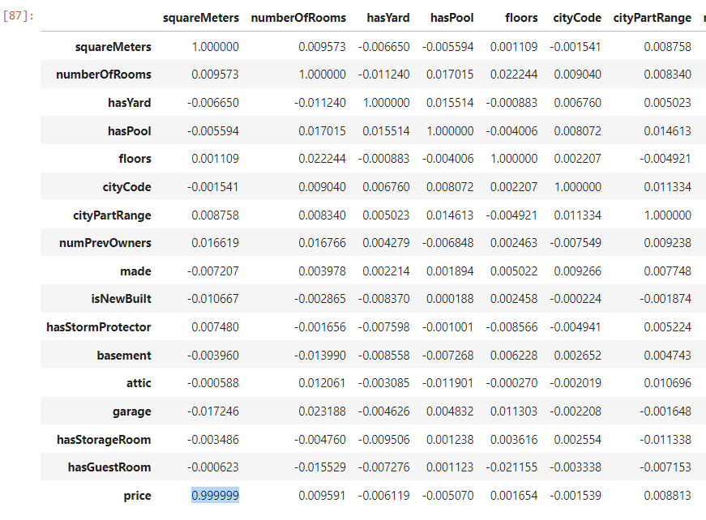
Correlations table
Only squareMeters has a significant correlation with price

Slide 5
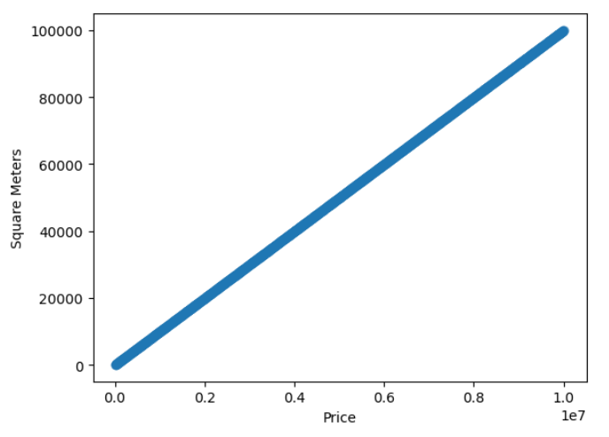
Scatter plot of squareMeters and price

Slide 6
Comparison with different variables
 | All independent variables (M1) | squareMeters only(M2)
R square | 99.99996% | 99.9998%
Formula | y = 4926.76 + 100x + … | y = 6460.88 + 99.999x
RMSE | 1921 | 3266

Slide 7
RMSE to the housing prices
 | Price | rmse | Percentage | RMSE | Percentage
1 | 7559081.5 | 1875 | 0.0248% | 3267 | 0.0432%
2 | 8085989.5 | 1875 | 0.0232% | 3267 | 0.0404%
3 | 5574642.1 | 1875 | 0.0336% | 3267 | 0.0586%
4 | 3232561.2 | 1875 | 0.0580% | 3267 | 0.0011%
5 | 7055052 | 1875 | 0.0266% | 3267 | 0.0463%
6 | 3926647.2 | 1875 | 0.0478% | 3267 | 0.0832%
7 | 5876376.5 | 1875 | 0.0319% | 3267 | 0.0556%
8 | 8696869.3 | 1875 | 0.0216% | 3267 | 0.0376%
9 | 5154055.2 | 1875 | 0.0364% | 3267 | 0.0634%
10 | 3970892.1 | 1875 | 0.0472% | 3267 | 0.0823%

Slide 8
Conclusion
Model one better predict the housing price
Higher R square
Lower root mean squared error
Cost vs benefit consideration
Model 1: slightly better attributes
Model 2: cost and time saving

Slide 9

Questions?

